Slide 1
Quantitative evaluation for PINNDE + Toy Flow-Matching Test
6/26 Weekly Update
Tina
GoSC26

Slide 2
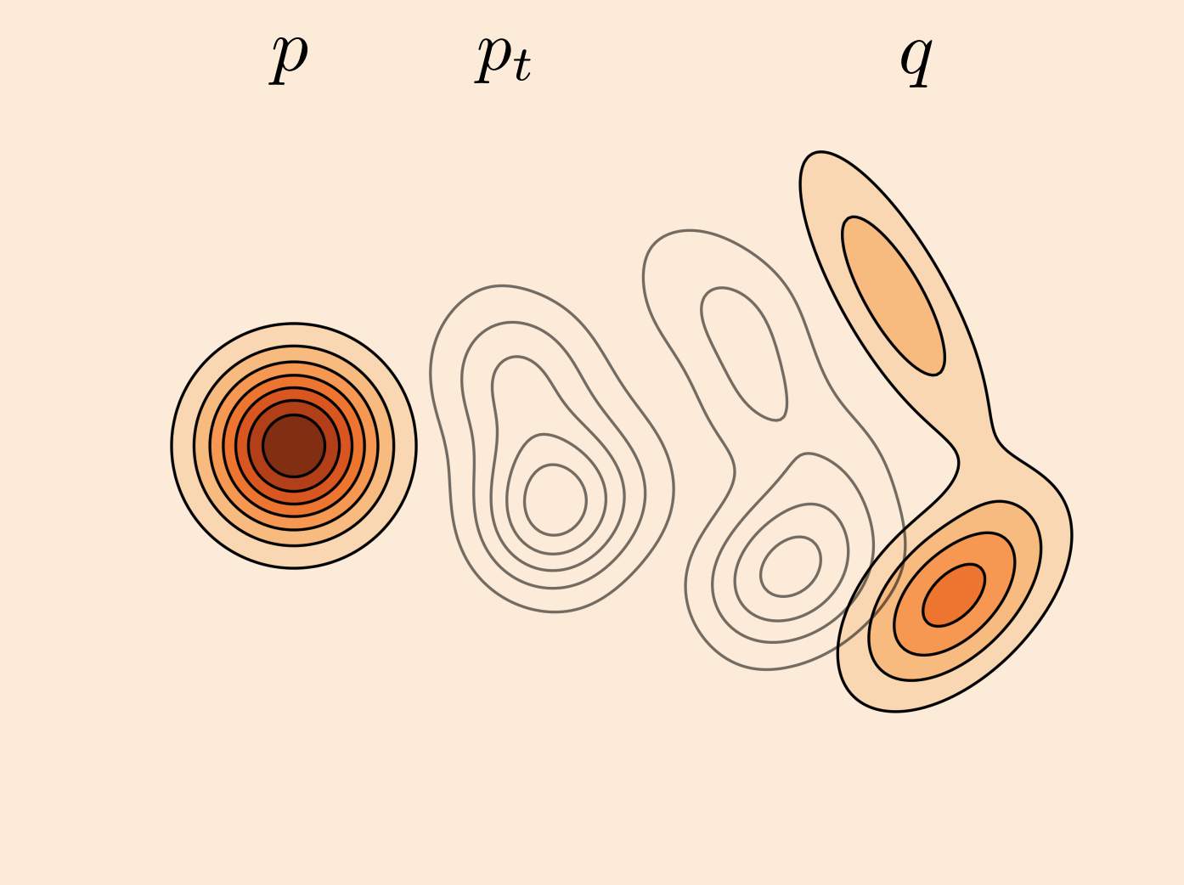
Motivation: no shared metric
Evaluation Module
Two PINNDE tracks: score-based (Sijil) and flow-matching (mine).
So far, validation is visual only, like corner plots, trajectory
Since now we have 2 models, it is hard to answer which is better by eye
Thus, we need a common quantitative metric that the 2 tracks (or even more) could compare against.

Slide 3
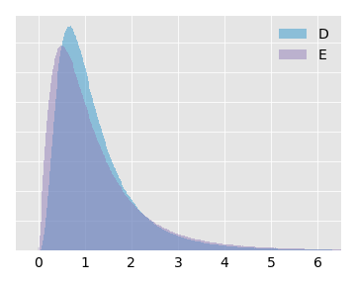
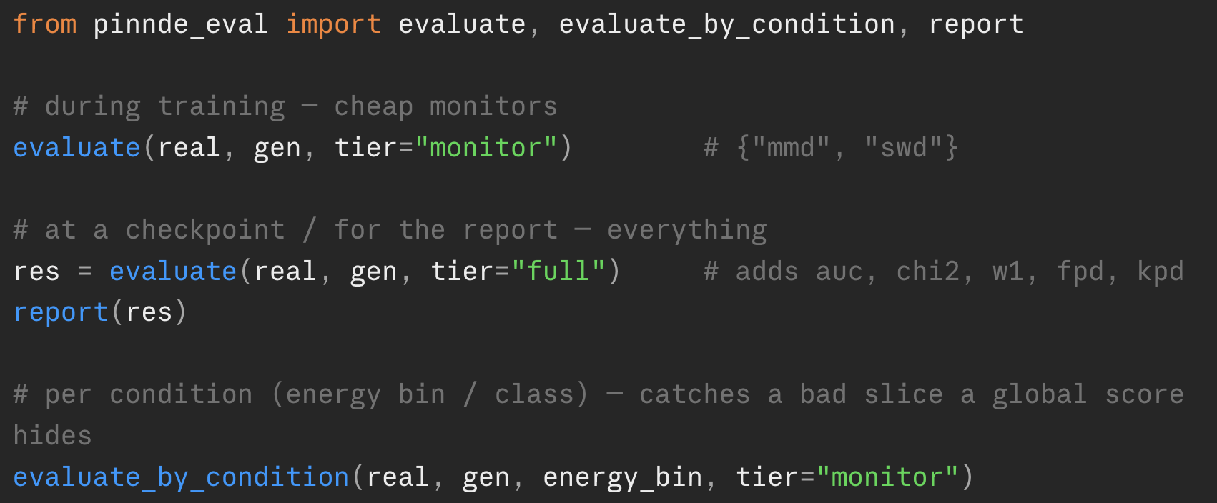
Metrics included
Evaluation Module
Real-time monitors - Is the training converging?
- Metrics: MMD, sliced-Wasserstein
Distances between distributions
- Metrics: FPD, KPD, per-feature Wasserstein
Standard tests - tell real from generated
- Metrics: classifier AUC, histogram χ²
Notes:
quick checks I run while it trains, to see if generated samples are getting closer to the data.

Slide 4
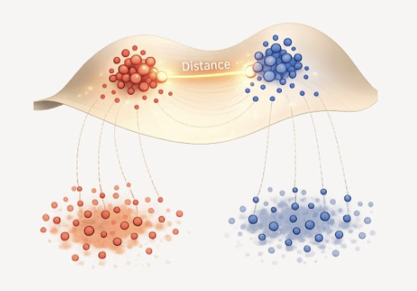
I Real-time monitors
Evaluation Module
Run every few hundred steps on ~1–5k samples.
mmd(real, gen) → float
What: unbiased squared Maximum Mean Discrepancy with a Gaussian RBF kernel; bandwidth set by the median heuristic.
Measures: overall distributional mismatch across all features at once. ≈0 means matched; can be slightly negative (unbiased estimator).
Use: m = mmd(real_batch, gen_batch) — log it as a convergence curve.
swd(real, gen, n_projections=128) → float
What: sliced Wasserstein — average 1-D Wasserstein-1 over random projections. Much faster than traditional Wasserstein
Measures: transport cost (how far samples must move to match); has real distance units, lower = closer.
Use: s = swd(real_batch, gen_batch)

Slide 5
II Distribution Distance
Evaluation Module
Statistically grounded, comparable across models, come with error bars.
wasserstein_per_feature(real, gen) → array (length d)
What: exact 1-D Wasserstein-1 distance, per coordinate
Measures: which individual feature is mismatched, it localizes the error.
fpd(real, gen) → (value, error)
What: Fréchet physics distance — 2-Wasserstein between Gaussian fits, with jetnet's infinite-sample extrapolation.
Measures: mismatch in mean + covariance; the standard generative-quality number. ~0 (within error) = match.
kpd(real, gen) → (median, error)
What: kernel physics distance — polynomial-kernel MMD, batched.
Measures: higher-moment mismatch the Gaussian-based FPD can miss; robust median + uncertainty.

Slide 6
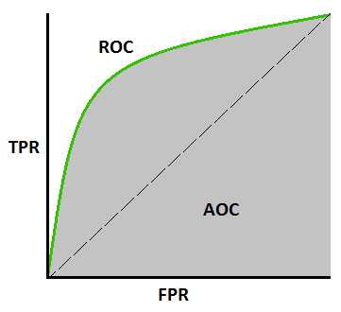
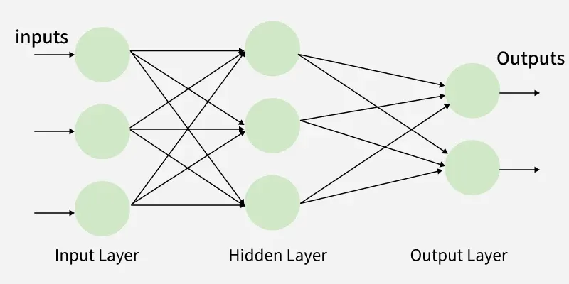
III Journal Standard
Evaluation Module
classifier_two_sample_test(real, gen, k=5) → (mean_auc, std_auc)
What: train a small MLP to tell real from generated; report held-out AUC over k retrainings.
Measures: whether any classifier can distinguish the two sets. AUC ≈ 0.5 = indistinguishable (ideal); → 1.0 = easily separated (bad). The std is the error bar.
Use: auc, std = classifier_two_sample_test(real, gen).
histogram_chi2(real, gen, bins=50) → array (length d)
What: reduced χ² between real/generated 1-D histograms, per feature (ROOT-style scaled statistic).
Measures: per-feature shape agreement. ≈1 = agree within statistics; ≫1 = the marginal is off.
Use: chi2 = histogram_chi2(real, gen) → mean and per-feature.

Slide 7
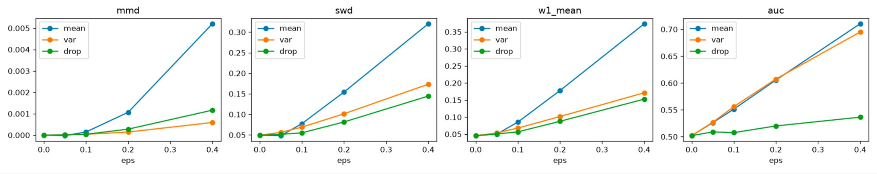
Module Test
Evaluation Test
The null test: given 2 independent draws of the same distribution
AUC ≈ 0.5, χ² ≈ 1, MMD/SWD distances ≈ 0.
Sensitivity test: perturb distribution (shift mean / scale variance / drop a mode) → every metric rises monotonically (Spearman ρ ≥ 0.8)
3. Speed test: the 2 real-time monitors: MMD ~180 ms, SWD ~10 ms on 5k points.
* PD/KPD numeric values pending environment, need a Colab run because of the missing jetnet package

Slide 8
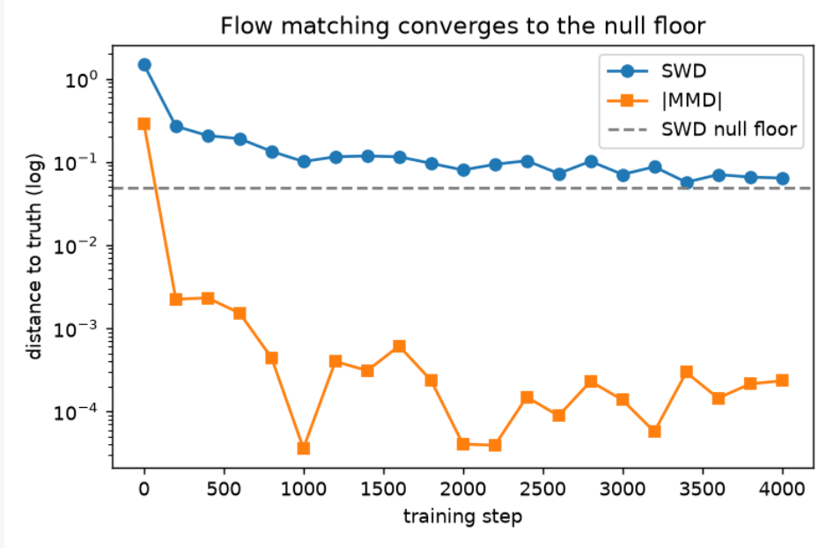
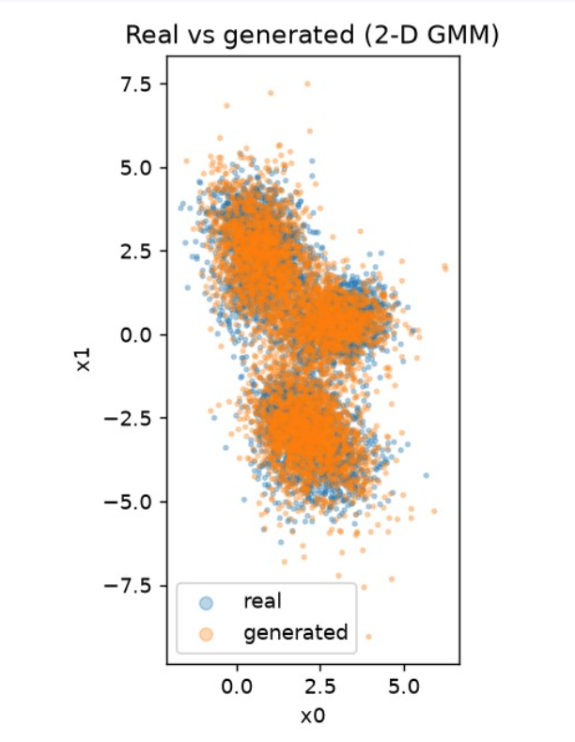
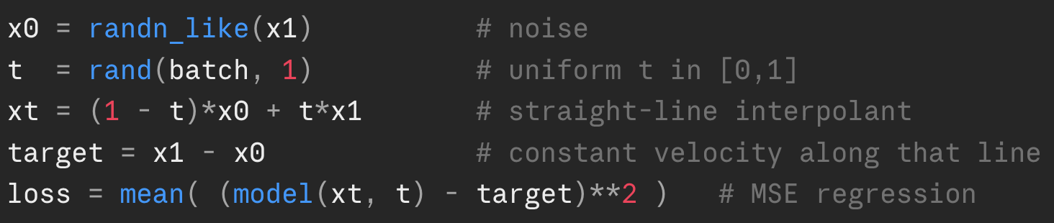
Flow-matching test
Flow-Matching
Does flow matching actually generate the right distribution?
Also test pinnde_eval
Since pinnde_eval is already calibrated on 2-D Gaussian mixture, I used a GMM
Training objective: Conditional flow matching, in the t=0 noise → t=1 data convention
20000 training, 5000 validation
Adam, lr 1e-3, batch 256, 4000 steps
Notes:
Now the first real use of the module: does my flow-matching track actually generate the right distribution? I tested on a 2D Gaussian mixture, because that's what the module is already calibrated on, so I'm testing the model and the module at the same time."
State the convention once and don't relitigate it: "Convention is t equals zero is noise, t equals one is data, the flow-matching-paper convention. Draw a noise point, draw a data point, put a point on the straight line between them, and train the network to predict the constant velocity that points from noise toward data. That's the whole objective in five lines." Gesture at the code.
"Setup: 20k train, 5k validation, Adam, 4000 steps."
The convergence plot is the money figure. Retitle it 'approaches the null floor,' not 'converges to.' Say: "SWD drops fast and then flattens just above the dashed line. That dashed line is the null floor, the best SWD achievable at finite sample size, which is not zero. The model gets close to it and sits a little above. I'll be precise about that gap on the next slide."

Slide 9
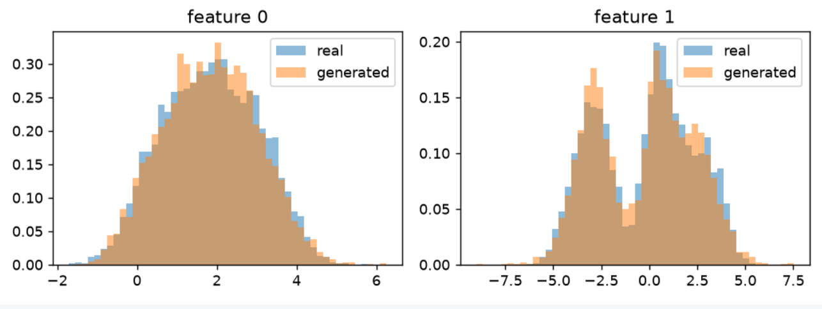
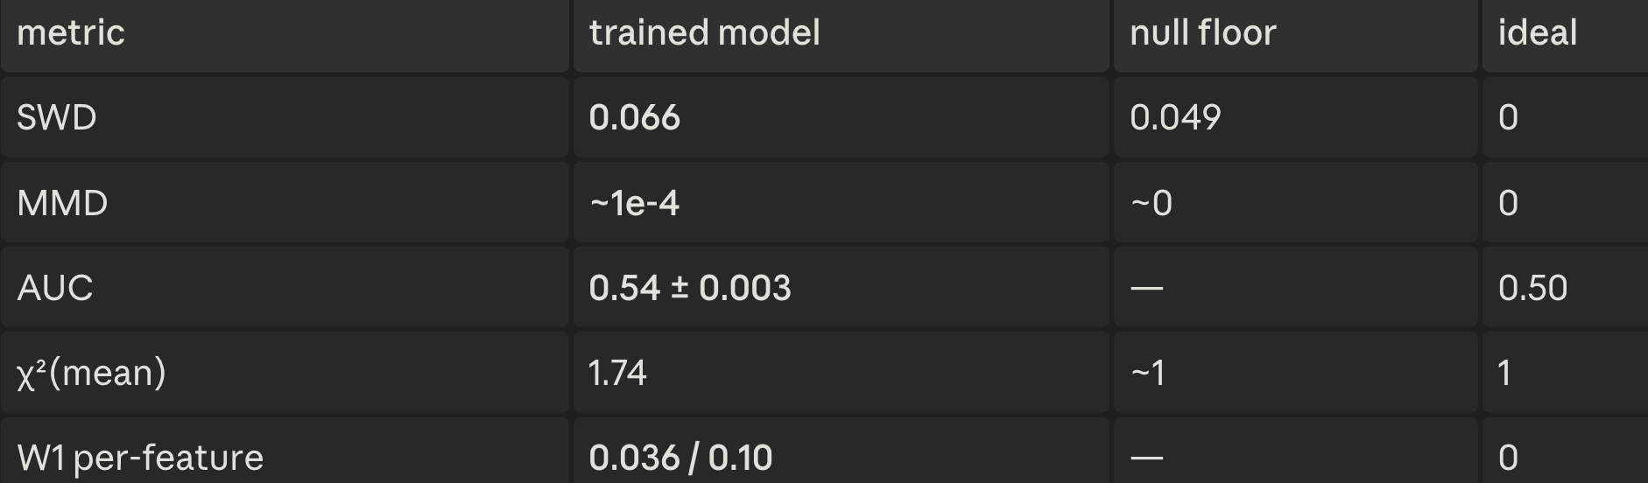
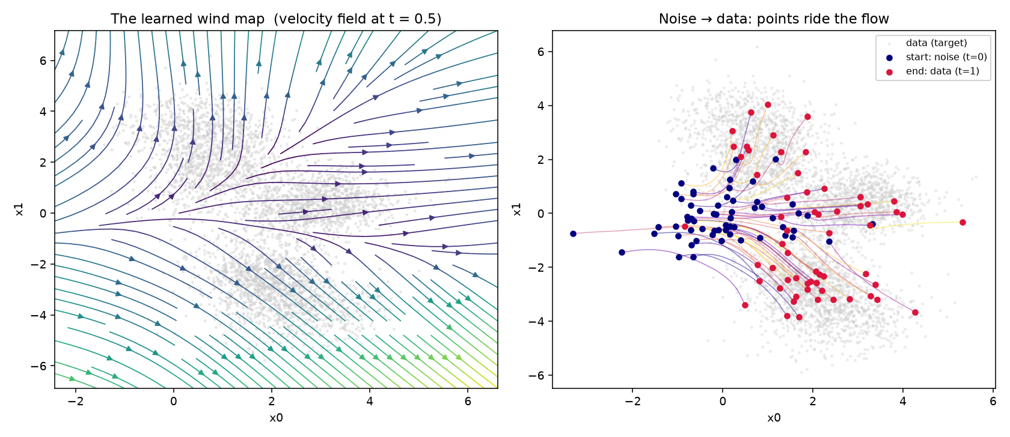
Flow-matching test
Flow-Matching
*per-feature W1 tells which coordinate the model is weakest on
dark purple/blue = slow, green/yellow = fast
Notes:
"SWD trained is 0.066 against a null floor of 0.049. So it's not at the floor, it's about 1.3 times above it. Small gap, but real."
"MMD is around 1e-4, essentially matched."
"AUC is 0.54 plus or minus 0.003. With that error bar, 0.54 is many sigma above 0.50, so a classifier can still tell them apart, just barely."
"Chi-squared mean is 1.74 against an ideal of 1, so the marginals are off beyond pure statistics."
"Now the interesting part: MMD says matched, but SWD, AUC, and chi-squared all say there's a small residual gap. That disagreement isn't noise. MMD at the median bandwidth is lenient on small mode-mass imbalances; the other three are sensitive to marginal shape. They disagree in exactly the way the theory predicts, and that is the entire argument for using a battery instead of one number."
Localize the defect: "Per-feature W1 is 0.036 on one coordinate and 0.10 on the other, and the feature-1 histogram shows why: feature 1 is bimodal, and the model slightly misplaces mass between the two modes. Three metrics agree on where the defect lives. That's a precise diagnosis a corner plot can't give you."
The wind-map and trajectory plots: "On the left is the learned velocity field at t equals 0.5, the wind map the points ride. On the right, noise points at t equals zero flowing along it to data at t equals one. Worth noting: every training target was a constant per pair, yet the learned field is curved and position-dependent, because the network learns the average velocity over all pairs passing through each point. The curvature in that left plot is that averaging made visible."
Land it honestly: "So the verdict is: flow matching learns approximately the right distribution, with a small residual gap localized to the bimodal coordinate, the kind you'd chase with more steps or a slightly bigger network. And the module pinned down exactly where the gap is. That's the result."

Slide 10
Midterm Proposal
Midterm Evaluation Plan
Done:
- Shared evaluation module, with 20 tests.
- Toy flow-matching baseline reaching the null floor.
Proposed:
- Flow-matching vs. score-MC baseline, on the same toy setup the score track uses (same dimensionality, same GMM/latent). Use pinnde_eval to score, by:
Cost / scaling, wall-clock per step and the O(batch) vs O(N·M) story, ideally a curve as N grows.
Quality using eval module: AUC, SWD, and (Colab) FPD
Hope: FM is cheaper and as good or better.
A detailed blog explaining the Flow Matching formulation idea. Include this toy example

Slide 11
Thanks

Slide 12
Flow-matching test
Flow-Matching
Detailed:
For each point we build one (input → target) pair:
Take a real data point x₁ (e.g. a point in one of the GMM dist).
Draw a random noise point x₀ ~ N(0, I).
Pick a random time t ∈ [0,1] and place a point on the straight line between them: x_t = (1−t)·x₀ + t·x₁.
The "correct" velocity along that straight line is constant: target = x₁ − x₀ (it points from noise toward data).
Ask the MLP: "at position x_t, time t, which way?" → vθ(x_t, t).
Loss = ‖ vθ(x_t, t) − (x₁ − x₀) ‖² (MSE)..
*per-feature W1 tells which coordinate the model is weakest on

